Slide 1
Intelligent Traffic Signal
Decision System
Using Combinational Logic
Presented by:
2620030692 Sathwika
2620030693 Sowmya
2620030694 Navaneeth
2620040019 Krithika Reddy

Slide 2
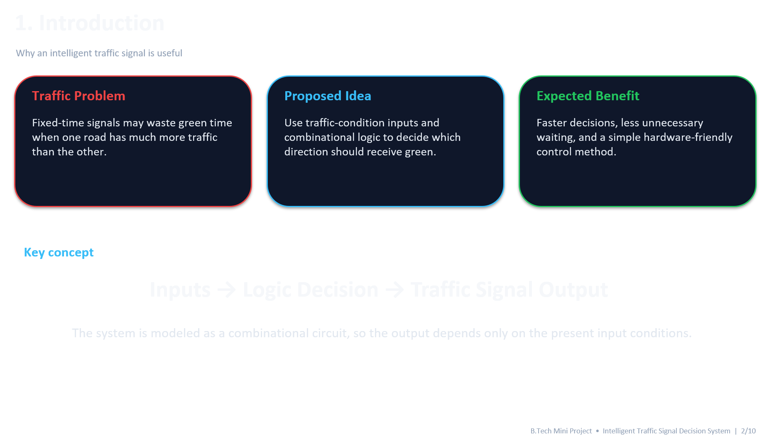

Slide 3



2. Problem Statement
Limitations of a simple fixed-time signal
• Green time may be given to a road even when traffic is low.
• A crowded direction may have to wait for a fixed cycle.
• Emergency vehicles need priority over normal traffic.
• A low-cost logic-based solution is useful for learning and prototype simulation.
Decision inputs
A
N–S traffic high
B
E–W traffic high
C
Emergency

Slide 4



3. Objectives
What the project is designed to achieve
Detect condition
Make decision
Use Boolean logic to select the appropriate traffic direction.
Represent traffic and emergency conditions using digital inputs.
Give priority
Simulate
Verify the truth table and outputs using a digital logic simulator.
Allow an emergency input to override normal traffic selection.

Slide 5






4. System Inputs & Outputs
Three binary inputs are used for a simple prototype
A — N–S Traffic
B — E–W Traffic
C — Emergency
1 = high traffic
0 = low traffic
1 = high traffic
0 = low traffic
1 = emergency present
0 = normal operation
GNS
GEW
Y / HOLD
North–South green signal
East–West green signal
Priority rule: C = 1 → emergency mode; normal traffic selection is disabled.

Slide 6





5. Combinational Logic Design
Boolean expressions for the normal operating mode
Meaning
Meaning
N–S gets green when N–S traffic is high, E–W traffic is low, and there is no emergency.
E–W gets green when E–W traffic is high, N–S traffic is low, and there is no emergency.
If A = B, neither normal green output is asserted. The controller can keep yellow/all-red for safe transition.

Slide 7
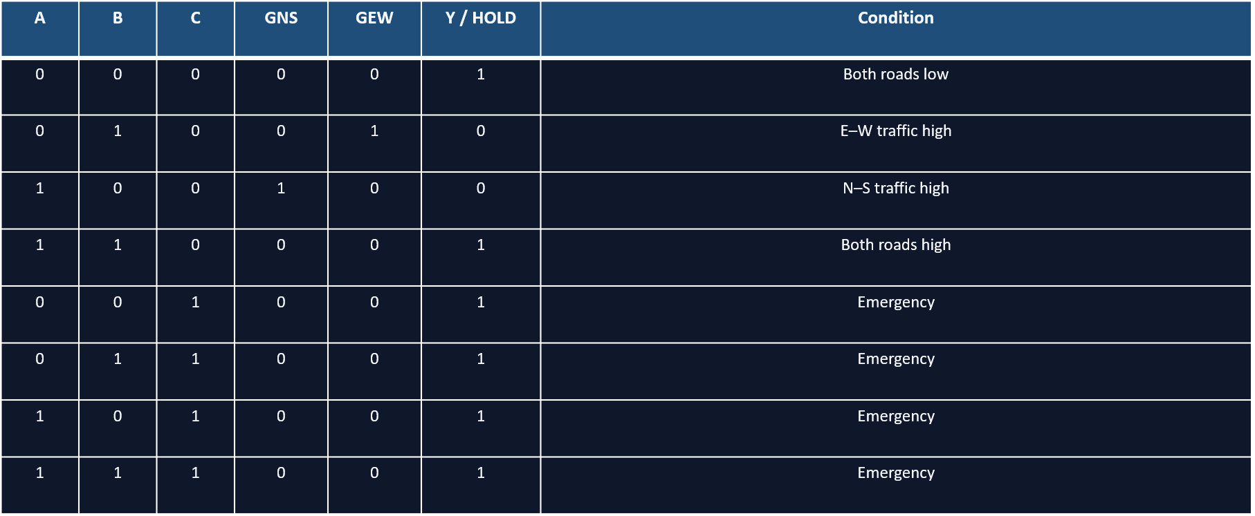
1 = HIGH/ON, 0 = LOW/OFF
6. Truth Table

Slide 8
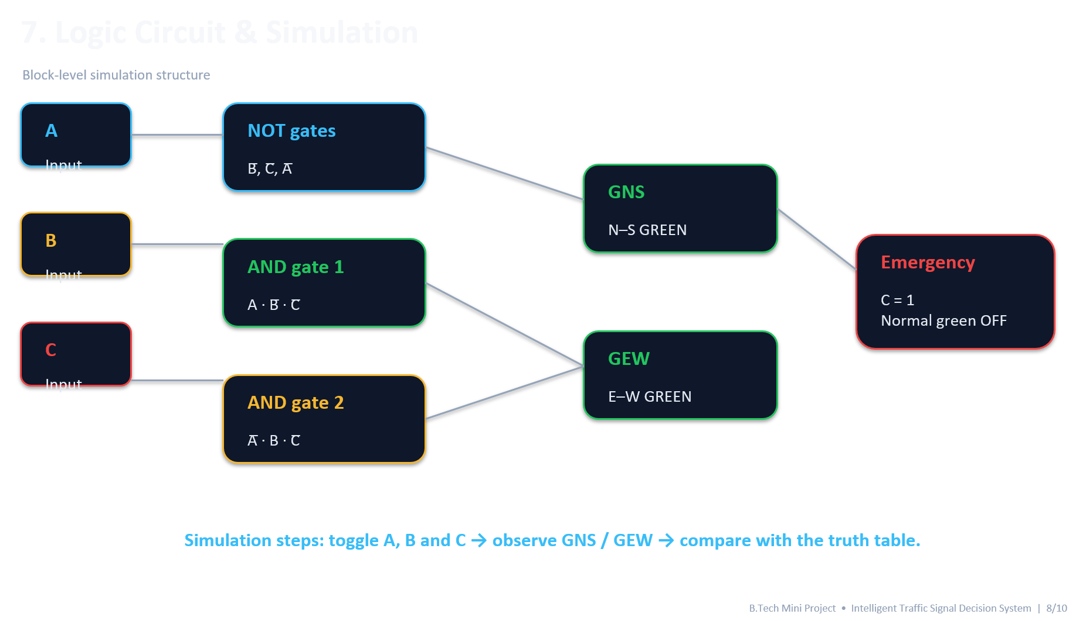

Slide 9
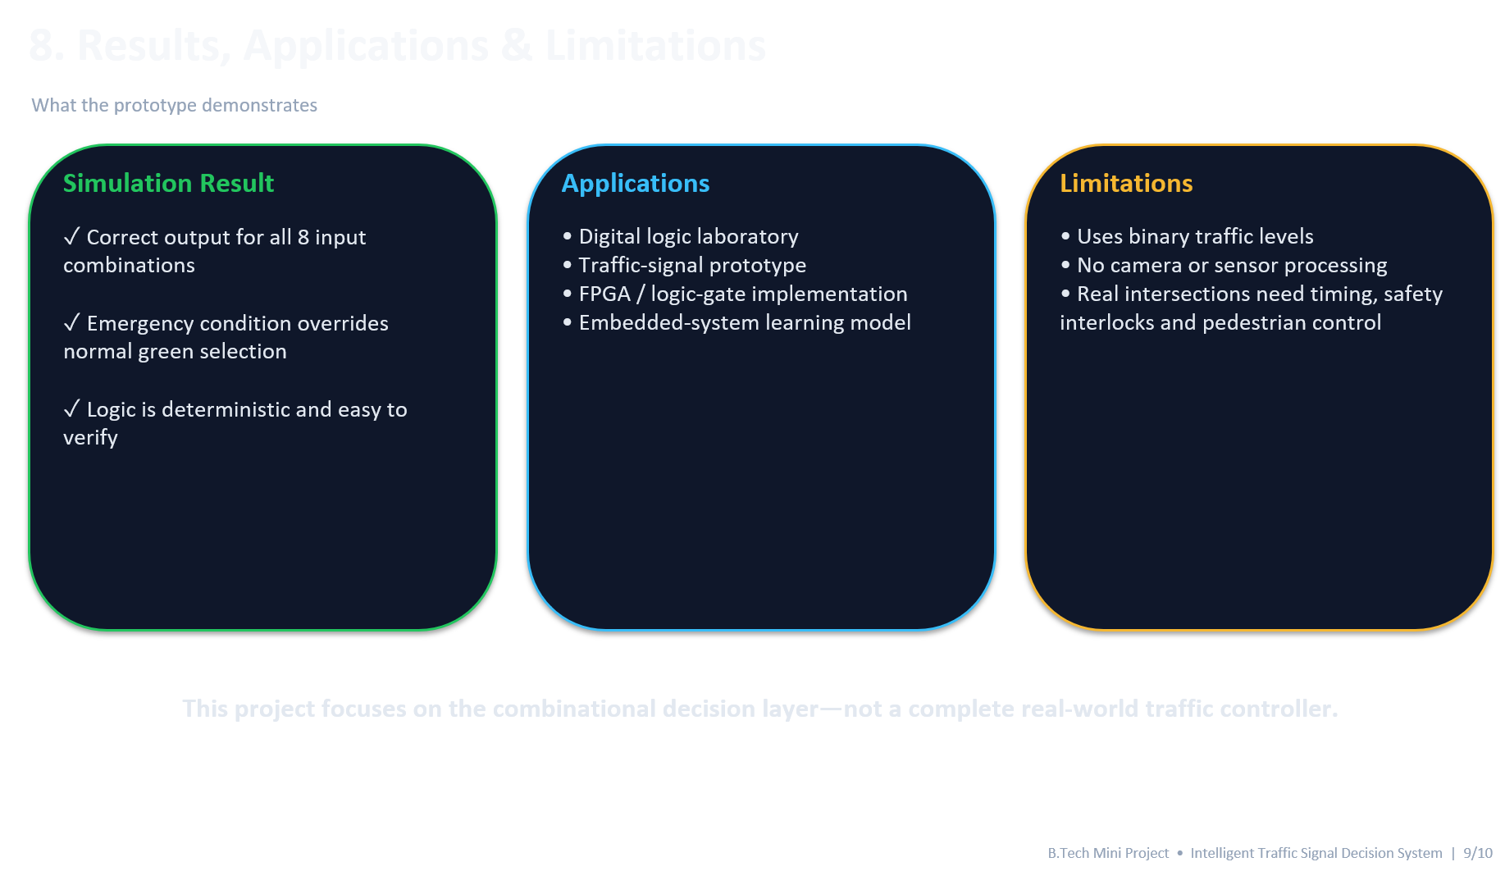

Slide 10

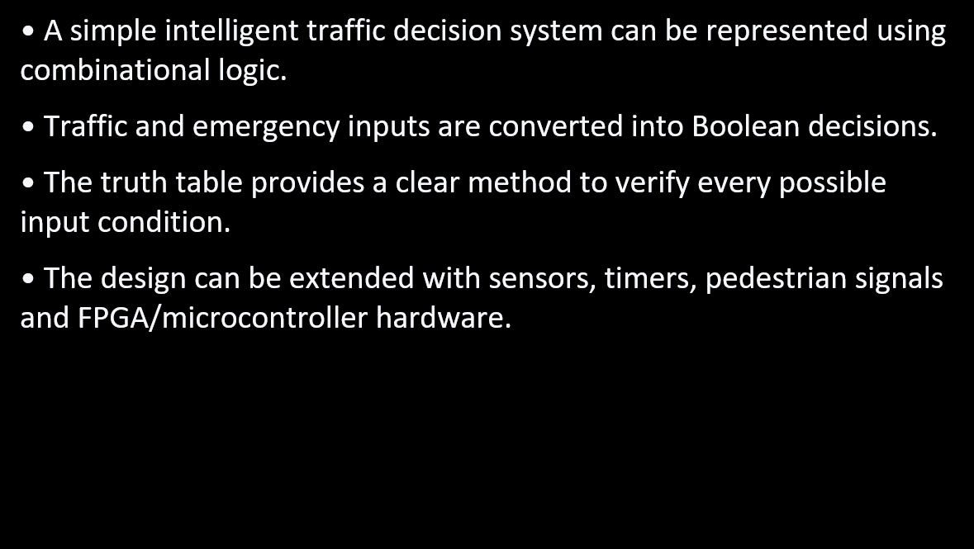

Takeaway
Summary
Present input → logic → output → simulation. This makes the project easy to explain and demonstrate.

